Slide 1
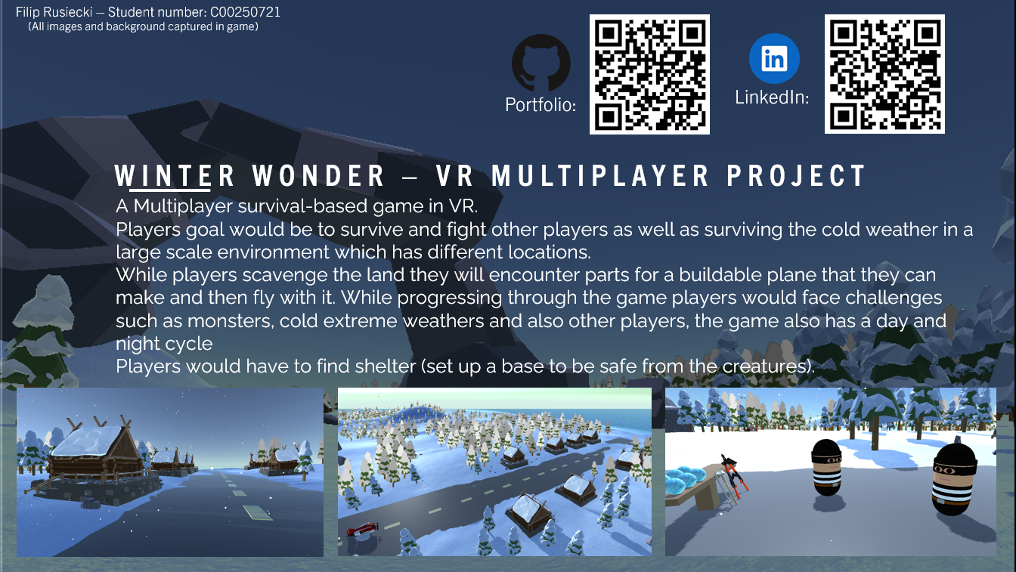
Winter Wonder – VR Multiplayer

